Slide 1
Suffix Trees on Words
A. Andersson, N. J. Larsson, and K. Swanson
1999

Slide 2
Content
Paper motivation
Proposed solutions and evaluation
Alternative solutions
Contributions
Future directions

Slide 3
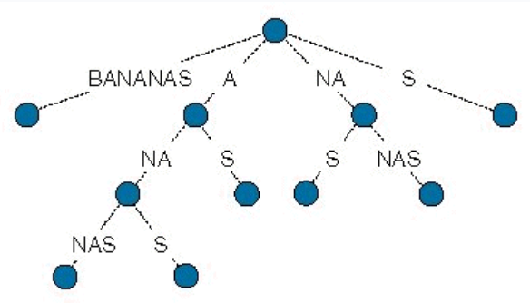
Paper motivation
The suffix tree is a very important and useful data structure for many applications.
Traditional suffix tree construction algorithms rely heavily on the fact that all suffixes are inserted, in order to obtain efficient time bounds.
Construction of a word suffix tree is nontrivial, in particular when only O(m) construction space is allowed.

Slide 4
Proposed solution
Solution is to present an algorithm with O(n) expected running time.
In general, construction cost is Ω(n) due to the need of scanning the entire input. Also in applications that require strict node ordering, an additional cost of sorting O(m՛) characters arises, where m ՛ is the number of distinct words.
Furthermore, when the alphabet is small, authors assumed that the n characters in the input string occupy O(n) machine words.

Slide 5
Implementation algorithms
Authors consider specifically the following possibilities:
Each node is implemented as an array of size k.
Each node is implemented as a linked list or as a binary search tree.
The edges at each node are hash-coded using dynamic hashing, that guarantees constant search time per node, even for a nonconstant alphabet (may be combined with 2).
Instead of storing pointers into the input string for each edge, the pointers are stored only at the leaves, and the character distinguishing each edge is stored explicitly.

Slide 6
Algorithm A
Build a traditional nonlexicographic suffix tree for the input string in Ɵ(n) time with a traditional algorithm, using hashing to store edges.
Refine the tree into a word suffix tree: remove the leaves that do not correspond to any of the desired suffixes, and perform explicit path compression. The time for this is bounded by the number of nodes in the original tree, i.e., O(n).
If so desired, make the trie lexicographic in time O(m + s(m)) (by Observation 1), where s(m) denotes the time to sort m characters.

Slide 7
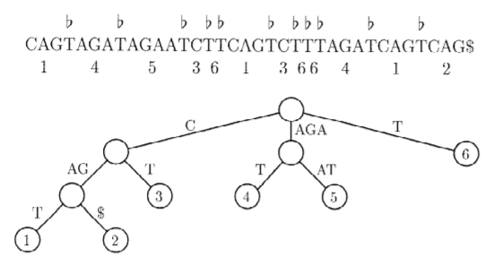
Algorithm B
A nonlexicographic trie with m՛ leaves is built, containing all distinct words: the word trie.
Next, this trie is traversed and each leaf (corresponding to each distinct word in the input string) is assigned its in-order number.
Thereafter, the input string is used to create a string of m numbers by representing every word in the input by its in-order number in the word trie. A lexicographic suffix tree is constructed for this string.
This number-based suffix tree is then expanded into the final nonlexicographic word suffix tree, utilizing the word trie.

Slide 8
Algorithm C
Construct a nonlexicographic word trie in the b-bit alphabet in time O(n՛). The padding of words does not change the important property of direct correspondence between the words and the leaves of the word trie.
Sort the edges of this trie, yielding a lexicographic trie in the b-bit alphabet in O(m՛ + sb(m՛)) time.
Assign in-order numbers to the leaves, and then generate the number string in time O(n՛).
Convert this word trie into a word trie in the original k-size alphabet.
Proceed from stage 4 of Algorithm B.

Slide 9
Evaluation of solution
The disadvantage of Algorithm A is that it as much space as traditional suffix tree construction.
Described solution allows search operations with a single access to secondary storage, using only O(m) cells of primary storage, regardless of the length of the search string.
Solution space requirement is better than that of alternative data structures.
An obvious advantage compared with the suffix array is the construction cost: it is needed only Ɵ (n) time, while Manber and Myers’ suffix array algorithm requires Ɵ (n log n) time.
The related problem of constructing evenly spaced suffix trees has been treated by Kärkkäinen and Ukkonen. Such trees store all suffixes for which the start position in the original text are multiples of some constant. Authors noted that their algorithm can produce this in the same complexity bounds by assuming implicit word boundaries at each of these positions.

Slide 10
Alternative solutions
Ukkonen’s or McCreight’s algorithm
Udi Manber and Gene Myers
Baeza-Yates and Gonnet
Asymptotically, described solution is better than that of alternative data structures, like the traditional suffix tree and the suffix array or PAT array. In practice, however, an asymptotic advantage may sometimes be neutralized by high constant factors.

Slide 11
Contributions
Baeza-Yates and Gonnet suggested inserting only suffixes that start with a word, when the input consists of ordinary text.
McCreight concludes that the use of hash coding, which implies a nonlexicographic trie, appears to be the best representation.

Slide 12
Future directions
One open problem remains, namely that of removing the use of delimiters—finding an algorithm that constructs a trie of arbitrarily selected suffixes using only O(m) construction space.

Slide 13
Any questions?

